Slide 1

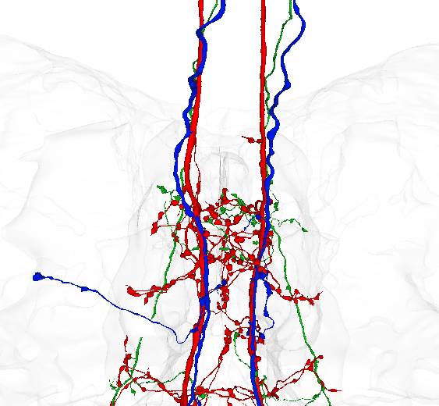
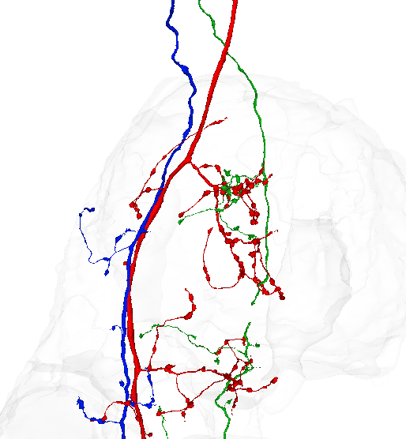
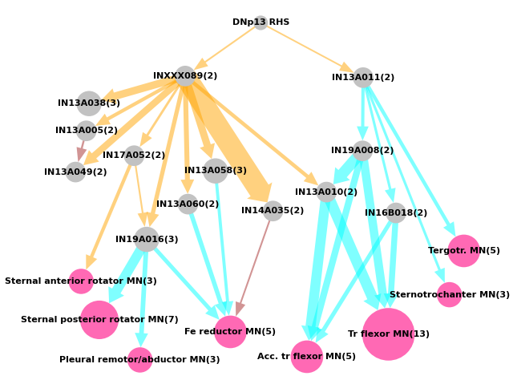
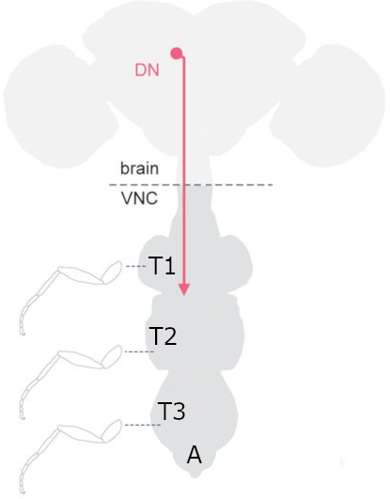
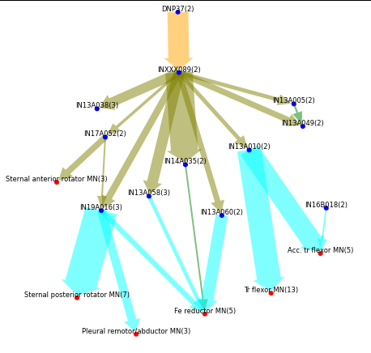
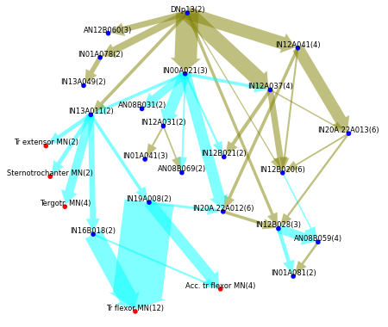
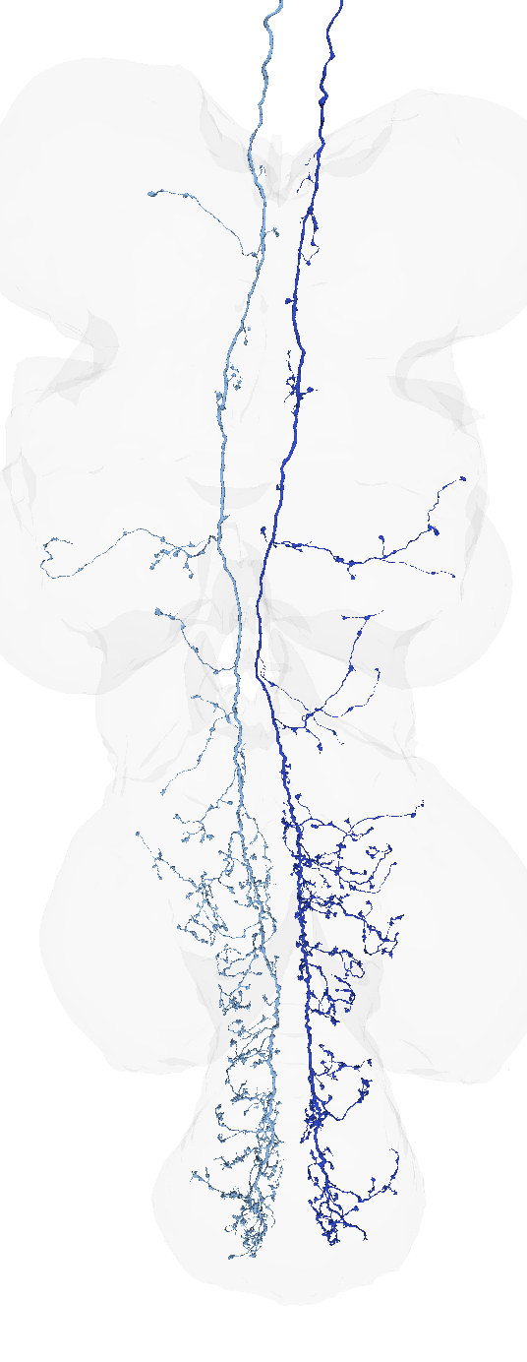
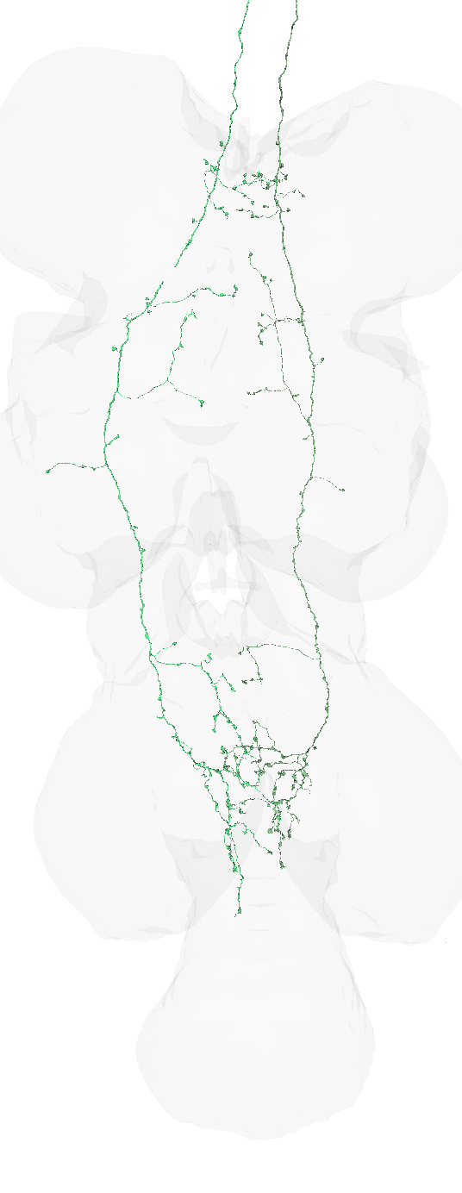
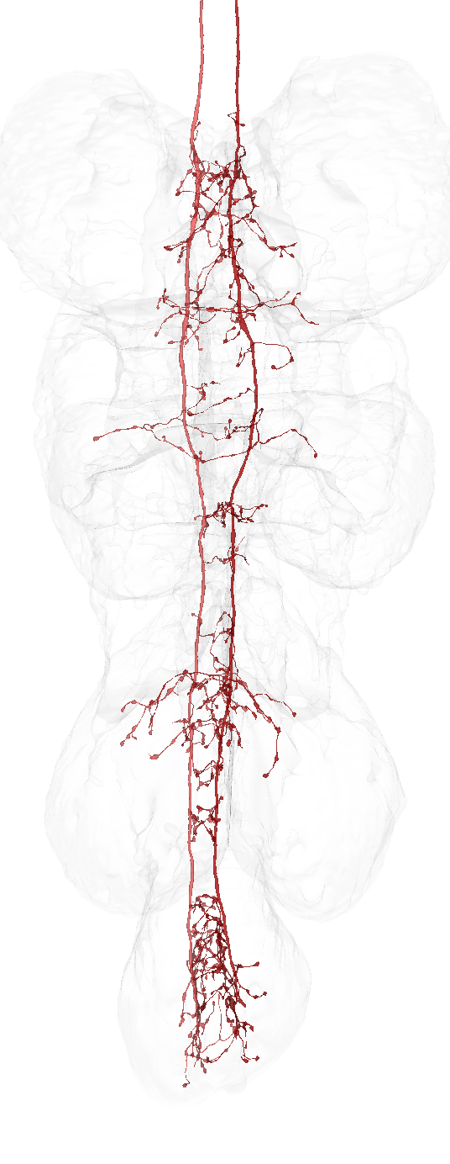
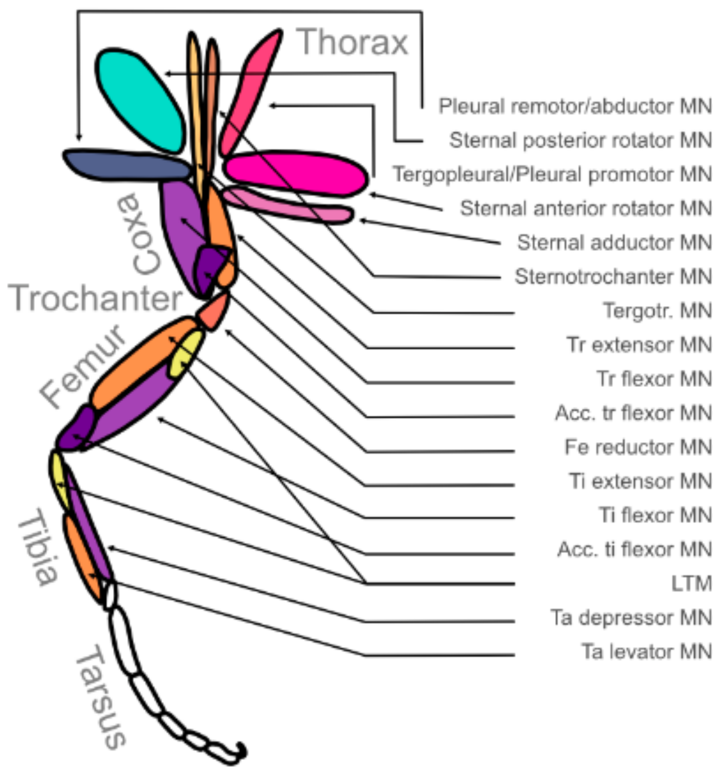



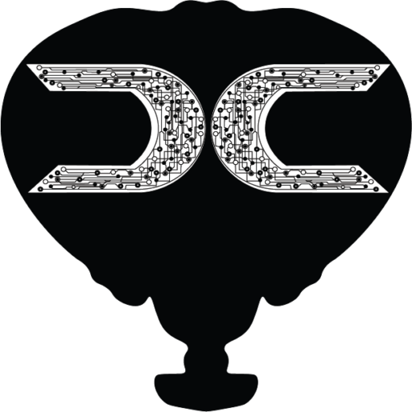

Investigating sexual dimorphism in the front leg circuits downstream of two descending neurons in Drosophila melanogaster
Drosophila Connectomics Group
Holly Whittome¹, Paul Brooks¹, Katharina Eichler¹, Tomke Stürner^{1,2}, Andrew Champion¹, Sebastian Cachero², Isabella Beckett², Lisa Marin¹, Han Cheong³, Billy Morris¹, Andrew Dacks⁴, Arti Yadav¹, Ilina Moitra¹, Stuart Berg³, Marta Costa¹, Gwyneth Card³, Greg Jefferis^{1,2}
¹Department of Zoology, University of Cambridge, Cambridge, United Kingdom ²Division of Neurobiology, MRC Laboratory of Molecular Biology, Cambridge, United Kingdom ³Janelia Research Campus, Howard Hughes Medical Institute, Ashburn, VA, USA ⁴Department of Biology, Life Sciences Building, West Virginia University, Morgantown, WV, 26506, USA
Introduction
A
B
Motor Neuron
Interneuron
GABA
Acetylcholine
Glutamate
A connectome is a high-res map of neurons, including synapses. The D. melanogaster connectome datasets have been made by taking electron microscope images of very thin slices of the fly’s CNS, which are reconstructed into 3D volumes using machine learning and human expertise.
The central nervous system of D. melanogaster consists of the brain and the ventral nerve cord (VNC) which is analogous to a mammalian spinal cord. Descending Neurons (DNs) receive input in the brain and relay signals to the ventral nerve cord, which is the fly’s motor centre.
A. Dorsal view of both neurons in each pair
B. Lateral view with left neurons only
Figure 1: Diagram of the D. melanogaster CNS adapted from [manc DN] the three thoracic neuromeres showing T1, T2 and T3, as well as the abdominal neuromere A. An example of a descending neuron is shown with the cell body in the brain and outputs in the VNC
Figure 3: Arborisation in T1. DNp37 in green, female DNp13 in blue and male DNp13 in red. Visualisation made by superimposing FANC data onto the shape of the MANC dataset.
Using the Drosophila Connectome to investigate neural circuitry
Figure 4: Network visualization of downstream connections from the T1 axons of Female DNp13 (from the FANC dataset).
The ventral nerve cord of D. melanogaster is divided into neuromeres. Thoracic neuromere 1 (T1- see Figure 1) contains the premotor circuits which control the movement of the front legs.
Method
To access the FANC dataset, Python CAVEclient[5] was used to fetch synapses to downstream neurons, and then the neurons downstream of those, sequentially with a limit of three hops removed from the original neuron. Roughly equivalent functions were used in NeuPrint[4] to fetch neurons downstream of the descending neurons in the MANC dataset.
The data was restricted to connections in the T1 area of the ventral nerve cord, and thresholds applied to limit the minimum number of synapses that constitute a connection
Due to the difference in imaging methods and accuracy of reconstruction, the FANC dataset has significantly fewer detectable synapses than the MANC dataset (74 million and 45 million respectively). Therefore the threshold for a significant "connection" between two neurons was set at 3 synapses in FANC, and 10 in MANC.
Using this synapse data, the input percentages (the number of input synapses from the upstream neuron as a percentage of total inputs onto the downstream neuron) were calculated. Input percentages are compared here instead of directly comparing synapse numbers in order to avoid biasing the data toward connections to large neurons which may form a negligible part of the large neuron’s total input.
Thoracic neuromeres T2 and T3 do likewise for the middle and back legs. The abdominal neuromere (A) of the VNC contains neurons controlling the movement of the abdomen.
We have reconstructed the DNs in the Female and Male Adult Nerve Cord connectome datasets (FANC [3] and MANC [6] respectively) and matched neurons between the two datasets with the goal of identifying DNs and circuits involved in sexually dimorphic behaviours.
This research focuses on two DN types: DNp13, which is sexually dimorphic, and DNp37, which is female-specific. Both types exist in pairs, with one neuron on each side of the fly.
Motor Neuron
Interneuron
GABA
Acetylcholine
Glutamate
Unknown Neurotransmitter
Figure 5: Network visualization of downstream connections from the T1 axons of Female-only DNp37 (from the FANC dataset).
A
B
C
Figure 2: dorsal views of 3 neuron types with VNC outline
A. Female-only DNp37 in green, from the FANC (Female Adult Nerve Cord) dataset.
B. Female DNp13 in blue, also from FANC.
Results
C. Male DNp13 in red, from the MANC (Male Adult Nerve Cord) dataset.
The connections downstream of the T1 axons of DNp13 and DNp37 are shown in Figures [X,Y,Z]. Each node represents not a single neuron but a single type. A type often consists of just two symmetrical neurons but sometimes more, with the largest number of neurons in a single type shown being the 13 trochanter flexor motor neurons [check this]. Node area is proportional to the number of neurons. Any neuron whose type only appears once is omitted from the graphs, as are most interneurons with no downstream partners.
Edges represent connections between neurons, with the thickness of the edge representing the average input percentage between neurons of the two types. As well as the minimum synapse numbers mentioned in the results section, the input percentages were subjected to a minimum threshold of 1% for the first hop, 1.2% for the second and 1.4% for the third.
DNp13 in females controls ovipositor extrusion [7] which plays a role in sexual rejection/acceptance as well as being necessary for egg laying [2]
Figure 6: Network visualization of downstream connections from the T1 axons of Male-only DNp37 (from the FANC dataset).
Conclusions
DNp13 (or pMN1) in males is less well studied. It develops in the presence of females, but not males [45]which suggests a reproductive function.
we wrote about the flexor muscles before, if they are targeted only in T1. So the inhibition of flexor/acc.flexor (that you potentially see for DNp37) would mean keep legs straight for. Behaviours that might require this could be reaching movements or for example keeping the front legs straight for the laying of an egg at the back.
In the case of DNp13 it is a disinhibition of the flexor/acc.flexor so potentially allowing another neuron to activate the muscles and pull the legs back in.
The Sternotrochanter is potentially posture related and so is the Pleural remotor abducer.
DNp37 also targets the rotators (Sternal anterior and posterior rotator). They sit in the thorax and as the name says they rotate the leg (like our arm in our shoulder). Potential excitation of the anterior rotator and inhibition of the posterior rotator would suggest a movement of the leg backwards and the body forwards.
DNp37 (also called pMN2[1], vpoDN[8]) only occurs in females. Recent research indicates that it controls the opening of the vaginal plate for mating[8]
In all of three pairs of neurons the main arborisation is in the lower part of the VNC, but all have axons along the whole primary neurite from the neck to the abdomen. This project aims to trace the connectivity downstream of the axons in T1 (see Figure 3) to ascertain what effect these primarily reproduction-related neurons may have on the movement of the front legs.
The one exception to this is the female DNp13 graph (Figure 4). FANC is the worse reconstructed of the two datasets and in the case of DNp13 this has led to the left hand side neuron not meeting the 1% input threshold for any downstream partner. However, the two strongest downstream connections from the right hand side neuron (INXXX089 and IN13A011, see figure 4) have symmetrical pairs whose incomplete dendrites pass close to left hand side DNp13. Therefore the percentage threshold for the first hop in this graph only was lowered to 0.6% in order to include both neurons in each pair.
Figure 7: Schematic of a Drosophila leg, adapted from [MANC DN]

